Slide 1
Westlake Beamer
ZX
Westlake University
June , 2025

Slide 2

Contents
Introduction
Methods
Results
Conclusions

Slide 3
Introduction

Slide 4
Introduction
The Weatlake Beamer based on CleanEasy Beamer theme provides a clean, professional look for academic and business presentations.
Key features:
Clean, minimalist design
Carefully chosen color scheme
Professional typography
Flexible block environments
Customizable footers and section pages
About this template
This presentation serves as both documentation and demonstration, showing the various elements and features available in the theme.
Introduction
June , 2025 4/20

Slide 5
Block environments
Example block
Example blocks can be used to showcase code, examples, or case studies.
Alert block
Alert blocks draw attention to critical information, warnings, or caveats.
Theorem
In a right-angled triangle, the square of the hypotenuse equals the sum of squares of the other two sides.
Definition
A prime number is a natural number greater than 1 that cannot be formed by multiplying two smaller natural numbers.
Introduction
June , 2025 5/20

Slide 6
Methods

Slide 7
Lists and Numbering
Bulleted list:
First level item
Second level item
Another second level
Third level item
Another first level item
Numbered list:
First step
Substep one
Substep two
Second step
Third step
Methods

Slide 8
Tables
Table: Sample table with booktabs style
Header 1 | Header 2 | Header 3
Row 1, Col 1 | Row 1, Col 2 | 123.45
Row 2, Col 1 | Row 2, Col 2 | 67.89
Row 3, Col 1 | Row 3, Col 2 | 456.78
Table styling
The Westlake theme works well with the booktabs package for professional-looking tables. Simple color alterations make tables more readable without being distracting.
Methods

Slide 9

Mathematical Equations
The Westlake theme includes proper mathematical typesetting:
E = mc²
F = G^{m1m2}
(1)
(2)
_{r}2
Maxwell’s equations in differential form:
$$Enter your equation here$$
Inline equations like E = mc² are also properly rendered.
Methods

Slide 10
Code Listings
1 # A simple Python
fibonacci ( n): """ Return the if n <= 0:
return 0 elif n == 1:
return 1
function
nth Fibonacci number """
2 def
3
4
5
6
7
8
9
10
11
12
13
else :
a, b = 0 , 1
for _ in range (2 , n + 1): a, b = b, a + b
return b
14 # Calculate the 10 th Fibonacci number
15 result = fibonacci (10)
16 print ( f" The 10 th Fibonacci number is { result }")
Methods

Slide 11
Figures and Graphics
y
f(x)
Figure: Sample placeholder image
x
Figure: Simple TikZ diagram
Methods

Slide 12
Results

Slide 13
Overlays and Animations
Beamer supports step-by-step revelations:
First point appears on slide 1
Results
June , 2025 13/20

Slide 14
Overlays and Animations
Beamer supports step-by-step revelations:
First point appears on slide 1
Second point appears on slide 2
This text appears after a pause.
Results
June , 2025 13/20

Slide 15
Overlays and Animations
Beamer supports step-by-step revelations:
First point appears on slide 1
Second point appears on slide 2
Third point appears on slide 3
Results
June , 2025 13/20

Slide 16
Overlays and Animations
Beamer supports step-by-step revelations:
First point appears on slide 1
Second point appears on slide 2
Third point appears on slide 3
This text appears after a pause.
And this content appears on slide 4.
Results
June , 2025 13/20

Slide 17
Overlays and Animations
Beamer supports step-by-step revelations:
First point appears on slide 1
Second point appears on slide 2
Third point appears on slide 3
This text appears after a pause.
And this content appears on slide 4.
Delayed Block
This entire block appears only on slide 5.
Results
June , 2025 13/20

Slide 18
Citations and References
Westlake works well with bibliographies and citations:
Sample citation
According to Einstein [1], space and time are relative.
Bibliography management
The theme is compatible with BibTeX, BibLaTeX, and other bibliography management tools.
Results

Slide 19
Custom TikZ Graphics
y
x
Figure: The unit circle with trigonometric functions
Results

Slide 20
Conclusions

Slide 21
Theme Customization
The Westlake theme can be easily customized:
Edit beamercolorthemeCleanEasy.sty to change colors
Modify beamerfontthemeCleanEasy.sty for different fonts
Adjust beamerinnerthemeCleanEasy.sty for layout changes
Update configs.tex for footer and section page customization
Conclusions

Slide 22
Final Thoughts
Benefits of Westlake
Professional appearance suitable for academic and business contexts
Careful attention to typography and spacing
High readability with suitable contrast ratios
Flexible design that works with different content types
The CleanEasy theme is designed to let your content shine without distractions
Conclusions

Slide 23
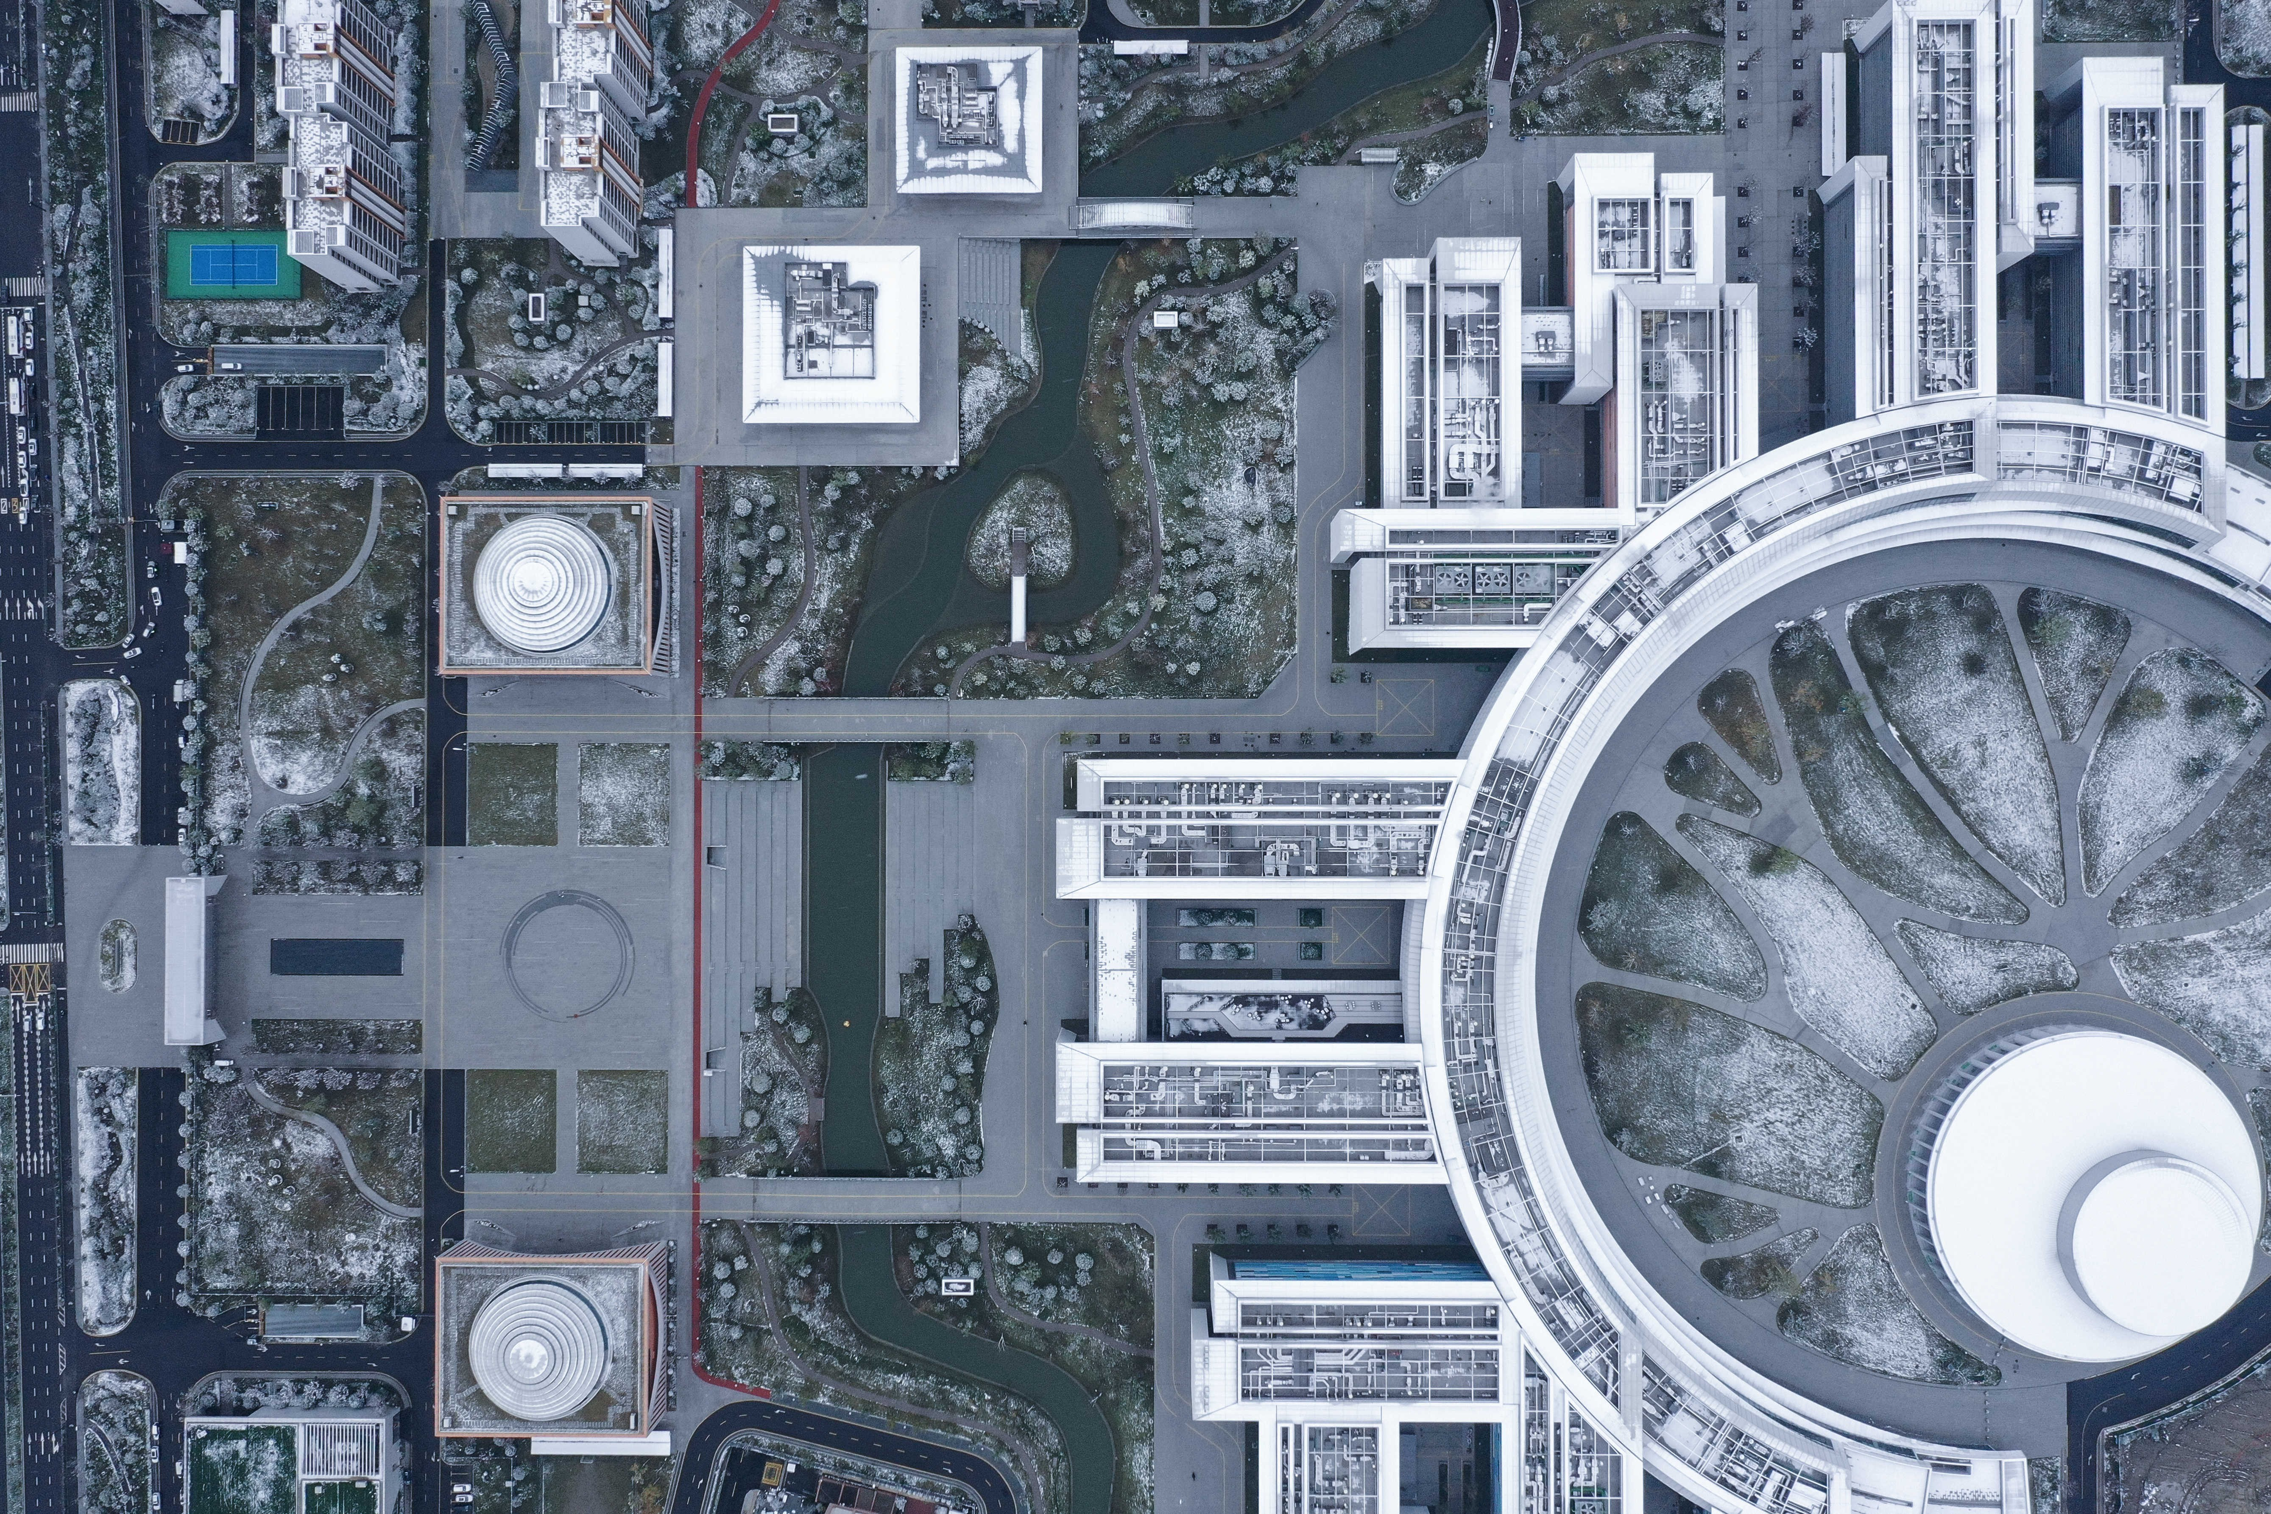
Thank you!
https://github.com/52liyitong/Westlake-beamer

Slide 24
References
Albert Einstein. On the Electrodynamics of Moving Bodies. Annalen der Physik, 1905.
Till Tantau. The Beamer Class. https://ctan.org/pkg/beamer
A. Name
Conclusions
June , 2025
20/20

